Slide 1




Big Data Analytics
Introduction
2019
By PhD. Samia Chehbi Gamoura
Associate Professor – EM Strasbourg
France

Slide 2

Agenda
Big Data
Analytics
Big Data Analytics
Concept
Role
As a field
Technically
Big Data Analytics Life Cycle
Data Processing
Hadoop
MapReduce
Data Quality
Big Data Analytics Project
Technological and Social Mutations
In Management
Applications
Predictive Management
Prediction in Unstructured BPM
Marketing/Sales Compliance
Supply Chain Advanced Risk Management
Supply Chain Predictive Risk Management
Data Concept
Data
Information
Knowledge
Big Data Concept
Volume
Variety
Velocity
Veracity
Big Data Life Cycle
Data Acquisition
Multi-Channels
Internet of Things
Cloud/Grid Computing
Data Storage
Data Base
Data Warehouse
Data Lake
Data Security
Concept
Types
Traditional Analytics
Business Intelligence (BI)
OnLine Analytical Processing (OLAP)
Advanced Analytics
Artificial Intelligence
Data Mining
Machine Learning

Slide 3
Agenda
Big Data
Analytics
Big Data Analytics
Concept
Role
As a field
Technically
Big Data Analytics Life Cycle
Data Processing
Hadoop
MapReduce
Data Quality
Big Data Analytics Project
Technological and Social Mutations
In Management
Applications
Predictive Management
Prediction in Unstructured BPM
Marketing/Sales Compliance
Supply Chain Advanced Risk Management
Supply Chain Predictive Risk Management
Data Concept
Data
Information
Knowledge
Big Data Concept
Volume
Variety
Velocity
Veracity
Big Data Life Cycle
Data Acquisition
Multi-Channels
Internet of Things
Cloud/Grid Computing
Data Storage
Data Base
Data Warehouse
Data Lake
Data Security
Concept
Types
Traditional Analytics
Business Intelligence (BI)
OnLine Analytical Processing (OLAP)
Advanced Analytics
Artificial Intelligence
Data Mining
Machine Learning

Slide 4

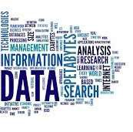
Big Data → Data Concept
What is ‘Data’ ?!
5min to answer…

Slide 5







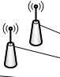




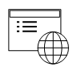
Big Data → Data Concept → Data
Data
Are the raw facts (or descriptions of facts) that were taken, observed, recorded, agreed, such as words, numbers, observations, surveys, etc.
Data are unprocessed facts, figures, schemas, etc.
In Information Systems (Computerized), Data is the input in the computer system.
Data doesn’t have a meaning !
Data
Sources

Slide 6

Big Data → Data Concept → Data
Data
2 kinds of Data :
Qualitative: textual or symbolic
Quantitative: numerical
Quantitative |  | Qualitative
Concept/Definition | Valuated facts | Describted facts
Methodology | Collected by | Collected by
 | measurement tools | observation
Analysis | Performed by statistical and numerical methods | Perfomed by specific adapted methods of classification, quantification, etc.
Results | Reported through statistic methods | Reported through a specific format/language

Slide 7
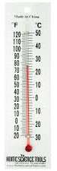





Big Data → Data Concept → Data
Data
Example
Meaning
What context ?
Temperature of what ?
24°
Data

Slide 8







Big Data → Data Concept → Information
Information
Is the raw fact that was taken, observed, recorded, agreed.
Information is processed
Processed Data become information.
Information is based on Data
Data
Data
Data
Processing
Information

Slide 9
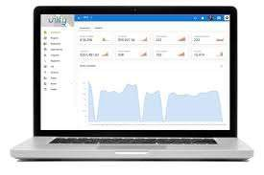






Big Data → Data Concept → Information
Information
Example
24° is
The Temperature of weather
In Strasbourg
• On 13/01/2019
24°
Information
Data

Slide 10










Big Data → Data Concept → Knowledge
Knowledge
Is the set of relationships between information elements following an ontology
Mapped information: how they are related, what is compound in what, where ?
There is ontology (definition of meanings) that frame the set of information
Data
Data
Data
Processing
Information
Information
Information
 | Ontology
Mapping

Slide 11

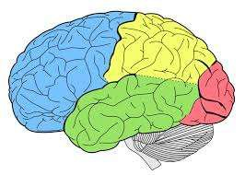


Big Data → Data Concept → Knowledge
Knowledge
Example
24° is
The Temperature of weather
In Strasbourg
• On 13/01/2019
Information
Knowledge
24°
Data
Decision:
Go out for a cruise

Slide 12
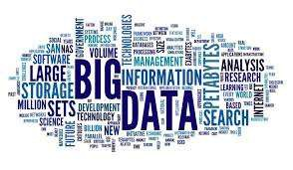
Big Data → Big Data Concept
What is ‘Big Data’ ?!
5min to answer…

Slide 13
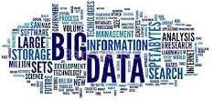
Big Data → Big Data Concept
Analyze
Volume
Market
Analytics
Management
Model
Variety
Web
Facebook

Slide 14
Big Data → Big Data Concept
Definition
Big Data is the field that gathers all activities and functions of :
Acquisition of Data,
Storage of Data.
from multiple sources that cannot be processed by common and traditional systems (for example ERP, Excel, etc.).
In Big Data, Data are :
4 V
Huge(Volume),
hetereougenious (Variety),
-
-
Dynamic (Velocity), Uncertain (Veracity).

Slide 15
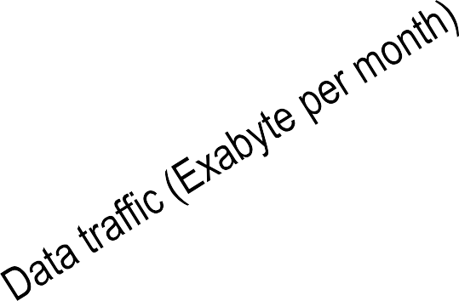
Big Data → Big Data Concept → Volume
Volume
The evolution of data stored and exchanged over time.
16.5
11.2
7.4
4.7
2.8
1.6
0.9
2012
2013
2014
2015
2016
2017
2018

Slide 16
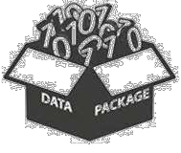
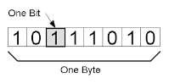
Big Data → Big Data Concept → Volume
Volume
The evolution of data stored and exchanged over time.
X 1024
X 1024
X 1024
X 1024
8 bits
Byte
KB
MB
GB

Slide 17

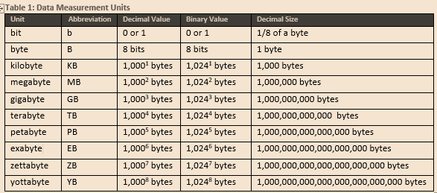
Big Data → Big Data Concept → Volume
Volume
The evolution of data stored and exchanged over time.
Data Measurement Units
Unit | Abbreviation | Decimal | Binary | Size

Slide 18
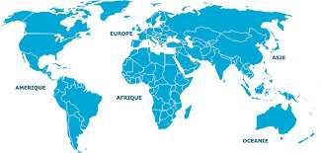
Big Data → Big Data Concept → Volume
Volume
Distribution of Data centers around the world.
North America: 45%
Europe : 32%
Middle East : 2%
Isles : 8%
Asie : 10%
South America: 2%
Africa : 1%

Slide 19
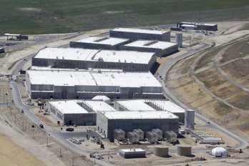
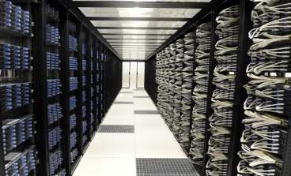
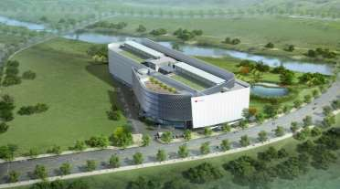
Big Data → Big Data Concept → Volume
Volume
Multiple Data centers around the world.
Data Center Utah (USA)
Data Center Vitry (France)
Data Center Busan (South Korea)

Slide 20


Big Data → Big Data Concept → Volume
Volume
Storage price decreasing.

Slide 21
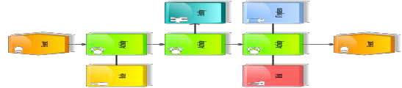





Big Data → Big Data Concept → Volume
Volume
Virtualization.
Cloud Computing
Managers
Finances
Customers
Developers
Help Desk
Users

Slide 22






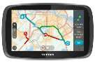

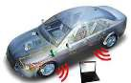
Big Data → Big Data Concept → Volume
Volume
Internet Of Things.

Slide 23




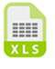
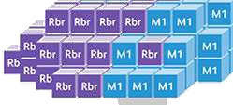
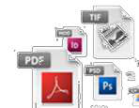

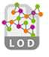
Big Data → Big Data Concept → Variety
Variety
No standard format of data in storages. Meta-Data of structures and organizations, semantic Data, images, videos, texts, XML, text formats, etc.

Slide 24








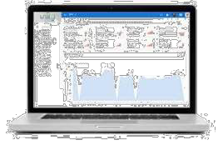



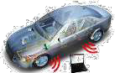
Big Data → Big Data Concept → Variety
Variety
Different sources.

Slide 25





Big Data → Big Data Concept → Variety
Variety
Structured and unstructured Data.
Raws
Fields
Data Base System
Name
Year
Number ID
Address
Alfred Bane
1980
5467364225
1 str Rest X
67000 Strg
Alfred Bane
1980
5467364225
1 str Rest X
67000 Strg
Alfred Bane
1980
5467364225
1 str Rest X 67000 Strg
Corporate transactions
Reports
Other data bases files
Tables

Slide 26





Big Data → Big Data Concept → Variety
Variety
Structured and unstructured Data.

Slide 27

Big Data → Big Data Concept → Variety → Applicative Exercise 1
Applicative Exercise 1
Group work. Duration 30min. Sore: 0.5
Try to list more than 10 data sources in at least 3 areas. For example RFID in Manucturing and Logistics
Data source
Type
Area
Image/Pattern
RFID
Chip with Digital code
Manufacuring / Logistics

Slide 28
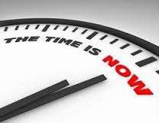

Big Data → Big Data Concept → Velocity
Velocity
Speed of data flows is going increasingly because of IT high process.

Slide 29






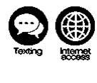
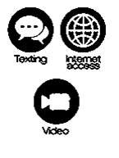
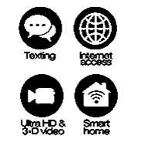
Big Data → Big Data Concept → Velocity
Velocity
Speed of data flows is going increasingly because of IT high progress.
1980 1991 1998 2008
2020 ?
1 G
2 G
3 G
4 G
5 G

Slide 30
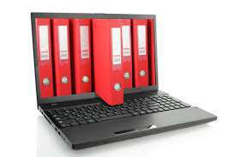
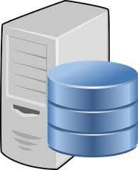

Big Data → Big Data Concept → Veracity
Veracity
Uncertainty of the data - Uncertain multichannel sources : Archive
Obsolete Data
Arcives
Important data not yet Digitized

Slide 31


Big Data → Big Data Concept → Veracity
Veracity
Uncertainty of the data - Uncertain multichannel sources : Multiple profiles
Fausses données (date naissance, pays, etc.)
fake profiles on social networks
False data (date of birth, country, etc.)
Multiple profiles

Slide 32

Big Data → Big Data Concept → Veracity
Veracity
Uncertainty of the data - Uncertain multichannel sources : Delegation
Delegation in transactions
False location of the interested party

Slide 33

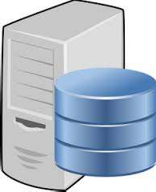
Big Data → Big Data Concept → Veracity
Veracity
Uncertainty of the data - Uncertain multichannel sources : forecasted by nature
Uncertain by nature
Ex. Meteorology for road management

Slide 34






Big Data → Big Data Life Cycle
Big Data Life Cycle
Data Acquisition
Data Storage

Slide 35
Big Data → Big Data Life Cycle
Big Data Life Cycle
Multiple Channels
Internet of Things
Cloud/Grid Computing
Data Acquisition
Data Base
Data Warehouse
Data Lake
Data Security
Data Storage

Slide 36

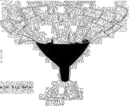
Big Data → Big Data Life Cycle → Data Acquisition
Data Acquisition
Is the process of collecting, cleaning, and filtering data before the data is put in a the storage.
Raw Data
Collecting
Cleansing
Filtering
Stored Data

Slide 37











































Big Data → Big Data Life Cycle → Data Acquisition → Multi-Channels
Multiple-Channels
Data streaming → structured and unstructured Data (mainly from Internet of Things)
Batch and Events sourcing → Data from insfrastructures (mainly from cloud and on Pro)
Real-time Data flows → Real-time/near real-time flows (mainly from Internet of Things and cloud)
Data transactions → structured Data (mainly from On Pro)
Cloud/Grid
Transactions
Batch
On Promise
Data Lake
From
Anything
At
Anytime
To
Anywhere
Things
Streaming
Real-time
Data
Warehouse

Slide 38



Big Data → Big Data Life Cycle → Data Acquisition → Internet of Things (IoT)
Internet of Things (IoT)
A set of devices that are able to connect and exchange data through Internet.
Embedded Computing > 233 billions USD/ 2021
----- Smaller
&
+++++ Faster

Slide 39
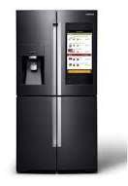
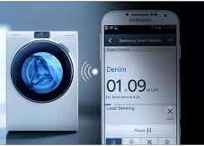
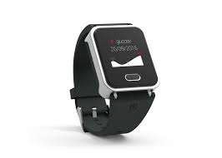

Big Data → Big Data Life Cycle → Data Acquisition → Internet of Things (IoT)
Internet of Things (IoT)
Smart fridge
Smart washing machine
Smart watch
Smart phone (smart assistant)

Slide 40
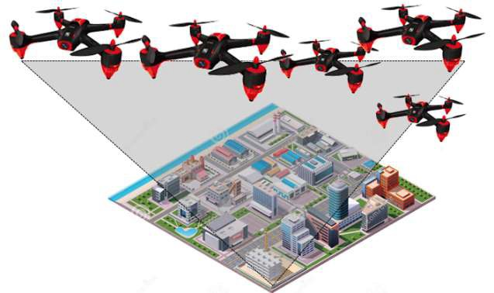
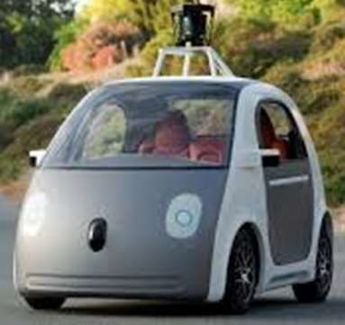

Big Data → Big Data Life Cycle → Data Acquisition → Internet of Things (IoT)
Internet of Things (IoT)
Smart cars
Smart drones
Smart printers

Slide 41

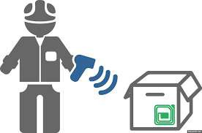

Big Data → Big Data Life Cycle → Data Acquisition → Internet of Things (IoT)
Internet of Things (IoT)
Smart Product
Logistics : Tracking, smart manufacturing, optimization

Slide 42
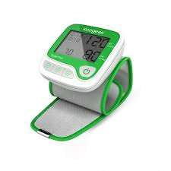
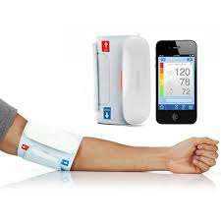

Big Data → Big Data Life Cycle → Data Acquisition → Internet of Things (IoT)
Internet of Things (IoT)
Smart Sphygmomanometer
Health : tele-visit, warning, emergency, geolocation, etc.

Slide 43
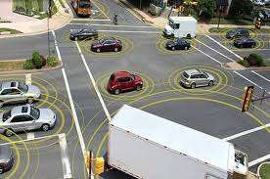

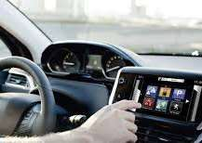
Big Data → Big Data Life Cycle → Data Acquisition → Internet of Things (IoT)
Internet of Things (IoT)
Smart car
Road safety: study of roads, traffic, tracking, verbalization, etc.

Slide 44

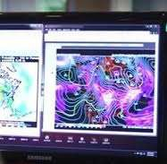

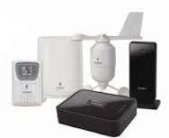
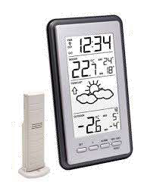
Big Data → Big Data Life Cycle → Data Acquisition → Internet of Things (IoT)
Internet of Things (IoT)
Smart thermometer
Meteorology: localized forecasting, weather risk prevention, weather warnings, etc.

Slide 45
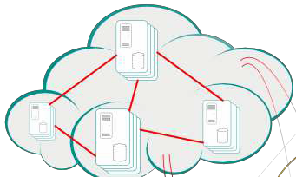
Big Data → Big Data Life Cycle → Data Acquisition → Cloud/Grid Computing
Cloud/Grid Computing
Computer resources that are located anywhere with access over Internet and processing Data and information in a distributed mode. They provide sharing, archiving, and high-scale.
Big Data

Slide 46
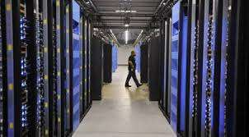
Big Data → Big Data Life Cycle → Data Storage
Data Storage
Storage infrastructure dedicated to save, protect, manage, recover, archives, alter, delete, and retrieve records of Data.
Storage Disks

Slide 47





Big Data → Big Data Life Cycle → Data Storage → Data Base
Data Base
SQL and especially NoSQL Data Bases like MongoDB, Cassandra ou Redis.

Slide 48




















Big Data → Big Data Life Cycle → Data Storage → Data Warehouse
Data Warehouse
Repository of Data (set of connected storages) regarding an organization in order to feed Data Marts usually used for Business Intelligence applications for reporting, dashboards, and decision making.
Data sources are usually transactional like ERP, CRM, SCM, etc.
Data are structured.
Data are stored in formated models (records and rows).
ERP
Data mart 1
Data Warehouse
CRM
Data mart 1
SCM
Data mart 1

Slide 49











Big Data → Big Data Life Cycle → Data Storage → Data Lake
Data Lake
A centralized architecture of one or more repositories of Data that are not related to one organization in order to feed Data Analytics (for processing).
Data sources are mutliple
Data are structured and unstructured
Data are stored in unformated models.
ERP
IoT
Analytics
Data Lake
SM

Slide 50





Big Data → Big Data Life Cycle → Data Storage → Data Security
Data Security
It is the set of methods and tools that aim to protect electronic privacy of people and enterprises against illegal access to Data from malicious uses.
Data

Slide 51
Agenda
Big Data
Analytics
Big Data Analytics
Concept
Role
As a field
Technically
Big Data Analytics Life Cycle
Data Processing
Hadoop
MapReduce
Data Quality
Big Data Analytics Project
Technological and Social Mutations
In Management
Applications
Predictive Management
Prediction in Unstructured BPM
Marketing/Sales Compliance
Supply Chain Advanced Risk Management
Supply Chain Predictive Risk Management
Data Concept
Data
Information
Knowledge
Big Data Concept
Volume
Variety
Velocity
Veracity
Big Data Life Cycle
Data Acquisition
Multi-Channels
Internet of Things
Cloud/Grid Computing
Data Storage
Data Base
Data Warehouse
Data Lake
Data Security
Concept
Types
Traditional Analytics
Business Intelligence (BI)
OnLine Analytical Processing (OLAP)
Advanced Analytics
Artificial Intelligence
Data Mining
Machine Learning

Slide 52
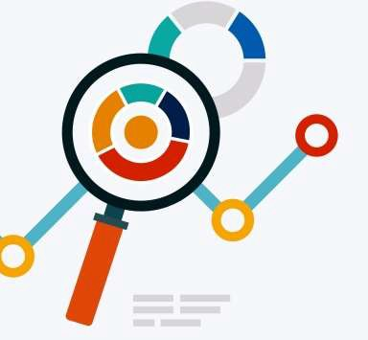
Analytics → Concept
Concept
Analytics denotes the set of methods, techniques, heuristics, and processes of analyzing data in order to find valuable information by:
Revealing hidden pattern,
Finding connections between concepts,
With this, businesses may take better/more accurate decisions.

Slide 53
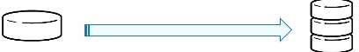
Analytics → Types
Types
In Business, there are 2 generations of Analytics :
Traditional Analytics: The set of common tools of analytics that use the data in a surface as to try understanding what is going on, what is the best result, what was the set best strategy, and so forth. This kind of Analytics does not need complex methods but common practices.
Examples: Excel, Oracle, ERP, etc.
Advanced Analytics: Some traditional tools cannot process the huge volumes of Data, so more complex methods are available in statistics, mathematics, artificial intellience, etc.
Example of volumes where Excel can’t exceed thousands of rows
Traditional Analytics

Slide 54



























Analytics → Types → Traditional
Traditional Analytics
Business Intelligence (BI) : tools that allow business to accumulate data from internal and external sources in order to provide dashboards, and reporting for management
OnLine Analytical Processing (OLAP): tool that allows users to selectively query data from different views dynamlically.
Manufacturing
Sales
OnLine Analytical Processing (OLAP)
Business Intelligence (BI)

Slide 55

Analytics → Types → Traditional → Business Intelligence (BI)
Business Intelligence (BI)
Tools that allow business to accumulate data from internal and external sources in order to provide dashboards, and reporting for management
Business Intelligence (BI)

Slide 56





Analytics → Types → Traditional → OnLine Analytical Processing (OLAP)
OnLine Analytical Pricessing (OLAP)
Tool that allows users to selectively query data from different views dynamlically.
Manufacturing
Sales
OnLine Analytical Processing (OLAP)

Slide 57



Analytics → Types → Advanced Analytics
Advanced Analytics
Artificial Intelligence : Any machine that observes the environment and decides automatically (through algorithms) to productively accomplishing goals.
Data Mining: The set of approaches that allow identifying patterns in a set of Data.
Meaningful information are extracted.
=
Data Mining
Artificial Intelligence

Slide 58
Analytics → Types → Advanced Analytics → Applicative Exercise 2
Applicative Exercise 2
Duration : 60min. Group Work. Score: 1.0
Context
Try to list more than 10 Companies that are specialized in Big Data Solutions for enterprises, with a brief description of each one, the names of the proposed products (software) and/or services (IT providing), and creation data of the activity.
Try to illustrate the evolution (history) of creation by dates and the number of companies by year in one chart. What do you have as result ?

Slide 59

Analytics → Types → Advanced Analytics → Artificial Intelligence
Artificial Intelligence
Reasonning: By rules, logic, deductions, generalization, etc.
Knowledge representation: by gathering commonsense objects.
Multi Agent Intelligence: by planning in a shared and parallel way for the same goals
Machine Learning: algorithms that try to learn from experience to improve the present and future.
Natural Lanuguage Processing: methods that allow the machine understanding the human language
Social Intelligence: methods that allow the machine (usually set of machines) to bypass the numeric intelligence and introduce the emotional and behaivioral intelligence.
And many other types and sub-types.
=
Artificial Intelligence

Slide 60
Analytics → Types → Advanced Analytics → Data Mining
Data Mining
- Is the set of tools that aim to find hidden patterns and relationships between Data and information to answer one or more issues for an enterprise. These issues can be prediction of actions or decision making.
Data Mining

Slide 61





Analytics → Types → Advanced Analytics → Machine Learning
Machine Learning
The set of computational methods that automate the acquisition of knowledge from experience.
In Enterprises application, Machine Learning uses Statistics, Mathematics, Computer Science, and Graphs Theory in engineering tasks related to business. This provides unseen patterns and diminish irregularities in human errors
Applications in management can be:
Stock prediction,
Accounting accuracy,
Insurance Fraud detection,
Bankruptcy prediction,
Risk Prediction,
Business Process Improvement,
And many others…
Machine Learning
Data Mining
Artificial Intelligence

Slide 62
Agenda
Big Data
Analytics
Big Data Analytics
Concept
Role
As a field
Technically
Big Data Analytics Life Cycle
Data Processing
Hadoop
MapReduce
Data Quality
Big Data Analytics Project
Technological and Social Mutations
In Management
Applications
Predictive Management
Prediction in Unstructured BPM
Marketing/Sales Compliance
Supply Chain Advanced Risk Management
Supply Chain Predictive Risk Management
Data Concept
Data
Information
Knowledge
Big Data Concept
Volume
Variety
Velocity
Veracity
Big Data Life Cycle
Data Acquisition
Multi-Channels
Internet of Things
Cloud/Grid Computing
Data Storage
Data Base
Data Warehouse
Data Lake
Data Security
Concept
Types
Traditional Analytics
Business Intelligence (BI)
OnLine Analytical Processing (OLAP)
Advanced Analytics
Artificial Intelligence
Data Mining
Machine Learning

Slide 63




Big Data Analytics → Concept
Concept
+
=
Big Data
Data Acquisition Data Storage
Analytics
Data Analysis Data Quality
Data Visualization Business Intelligence (BI) OLAP (Online Analytical Processing)
Machine Learning (ML) AI (Artificial Intelligence)
Big Data Analytics

Slide 64












Big Data Analytics → Concept
Concept
A wide cloud of data in dynamic flows.
devices
documents
sensors
transactions
logs (tracks)
videos
spatial coordinates
Images
software
Bar codes
RFID

Slide 65



Big Data Analytics → Concept
Concept
A wide cloud of data in dynamic flows.
In order to take advantage of these huge Data and understand them
We have to read them, to classify them, to explore them
BUT…!

Slide 66
Big Data Analytics → Concept
Concept
A wide cloud of data in dynamic flows.
banking transactions
GPS coordinates
Unstructued Data
Facebook posts
…
text
Supports and heterogeneous formats
Data Bases
Media: Images, videos
Files (pdf, word, binay, etc.)
Bar cordes, RFID, etc.
…

Slide 67


Big Data Analytics → Concept
Concept
A wide cloud of data in dynamic flows.
Diversity in Data sets makes the mining complex by humans and even by machines !
Hence the use of advanced methods to mine
All of these methods constitute the BIG DATA ANALYTICS

Slide 68
Big Data Analytics → Concept
Concept
Big Data Analytics are the set of tools that aim to process the stored Big Data in order to :
Reveal hidden patterns,
Discover unknown correlations,
Forecasting market trends,
Finding customer preferences,
Accurating forecastings,
Unconvering unexpected information and knowledge.
• …

Slide 69
Big Data Analytics → Role
Role
Descriptive Analytics:
What happened
Diagnostic Analytics:
How it happened
Predictive Analytics:
What will happen
Prescriptive Analytics:
What should happen
Cognitive Analytics:
Make it happening
Artificial Intelligence
Automation

Slide 70























Big Data Analytics → As a field
As a field
Statistics
Mathematics
Computer Science
Data Analysis
Machine Learning
Big Data
OLAP
Business Intelligence
Data mining
Artificial Intelligence
Big Data Analytics

Slide 71


























































Big Data Analytics → Technically
Technically
Social media
Cloud Coomp.
Middle wares
ERP
Data Sources
datawar^{d}hªo^{ta}u^{m}se^{art}
1
IoT
Unstructured Data
Structured
IoT
Data
datamart
Data Accumulation
Daya Analytics

Slide 72
Big Data Analytics → Technically → Applicative Exercise 3
Applicative Exercise 3
Group work. Duration 1 week. Score 1.0
Try to list more than 10 applications of Bid Data Analytics in Management/Business with information about area, concerns, and possible Data sources. For example Segmentation of Customers (finding hidden segments of new customers) in Customer Relationship Management (CRM) as following.
Application Area Concern Data sources
Customers Customer Helping in opening new Data sources: Demographic Segmentation Relationship markets and/or new Data from territories, social Management market/products media (new population), opportunities weater/tourism (seasonable products), etc.

Slide 73







Big Data Analytics → Big Data Analytics Life Cycle
Big Data Analytics Life Cycle
Data Accumulation
Data Analytics
Data Storage

Slide 74
Big Data Analytics → Big Data Analytics Life Cycle
Big Data Analytics Life Cycle
Multiple Channels
Internet of Things
Cloud/Grid Computing
Data Acquisition
Big Data
Data Warehouse
Data Security
Data Storage
Data Processing
Data Quality
Analytics
Data Analytics

Slide 75
Big Data Analytics → Big Data Analytics Life Cycle → Applicative Exercise 4
Applicative Exercise 4
Individual work. Duration 20min. Score 0.5
Try to find and distinguish between the paradigms ‘Data’, ‘Information’, and ‘knowledge’ in the figure below (Figure Big Data Analytics Life Cycle).
Data Accumulation
Data Analytics
Data Storage

Slide 76

Big Data Analytics → Big Data Analytics Life Cycle → Data Processing
Data Processing

Slide 77


Big Data Analytics → Big Data Analytics Life Cycle → Data Processing
Data Processing
A number of frameworks exist for data parallel processing:
Spark: Open-source more adapted for wide assortment of workloads and more powerful in streaming mode.
Hadoop MapReduce: Open-source framework processes Data stored in HDFS format (Hadoop Distributed File System), with an algorithm MapReduce and a combined with the Data Base Hbase. It is more adapted for wide volumes of data and more powerful in batch mode..

Slide 78

Big Data Analytics → Big Data Analytics Life Cycle → Data Processing → Hadoop
Hadoop
Hadoop

Slide 79

Big Data Analytics → Big Data Analytics Life Cycle → Data Processing → MapReduce
MapReduce
MapReduce

Slide 80

Big Data Analytics → Big Data Analytics Life Cycle → Data Quality
Data Quality
Is the set of operations for cleansing of Data by improving truthfulness, consistency, compliance, and significance. The management of these operations in the field of Big Data Analytics is called ‘Master Data Management’

Slide 81



Big Data Analytics → Big Data Analytics Project
Big Data Analytics Project
Step 1
Identify the context and the objective(ex. Target Marketing)
Etape 2
Aggregate the Data (ex. Buy and open Data flows from FB, and/or Open-Data)
Etape 3
Exploration of the accumulated Data (ex. Hadoop, MapReduce , Cassandra, ..)

Slide 82


Big Data Analytics → Big Data Analytics Project → Applicative Exercise 5
Applicative Exercise 5
Try to export an Excel file of Data from the Open Data of French government (ex. agriculture data of Strasbourg) (https://www.data.gouv.fr/)

Slide 83







Big Data Analytics → Technological and Social Mutations
More complexity (algorithms)

Slide 84










Big Data Analytics → Technological and Social Mutations
More complexity (algorithms)
New jobs: statisticians, data scientists

Slide 85














Big Data Analytics → Technological and Social Mutations
New disciplines: Data visualization
More complexity (algorithms)
New jobs: statisticians, data scientists

Slide 86









Big Data Analytics → Technological and Social Mutations
New disciplines: Data visualization
More complexity (algorithms)
New jobs: statisticians, data scientists
New trends: Predicting in real time

Slide 87
















Big Data Analytics → In Management
In Management
Big Data
Analytics
Patterns Discovery and Data Visualization
Predictive Management
Real-time Management

Slide 88











Big Data Analytics → In Management → Applications
Potential and new customers
Products
targeting
Smart Logistics
Enterprise
Fraud detection
Predictive stock
management
Delivery optimization
Predictive advertising

Slide 89

Big Data Analytics → In Management → Applications
DDV
Data Discovery and Visualization
Value (Goal):
Discovery of hidden knowledge
How →
query, filter, streamline, detect
PDA
Predictive Data Analysis
Value (Goal):
Predictive management
How →
extrapolate, forecast, predict
B D A
EDA
Exploratory Data Analysis
DRM
Data Reduction Methods
Value (Goal):
Infrastructures Costs reduction
How →
evaluate, tend
i
n
DDM
Data Deduction Methods
Value (Goal): Decision Making
How →
analyze, regulate,
select
M
a n a g e m e n t
CDA
Confirmatory Data Analysis
DSM
Data Statistical- inference Methods
Value (Goal):
Proof of assumptions
How →
infer, compare, interpret
QDA
Qualitative Data Analysis
DQM
Data Quantification Methods
Value (Goal):
Interpretation of non-numerical data
How →
quantify, evaluate, classify
RTA
Real-Time Analysis
DEM
Data Event- oriented Methods
Value (Goal) :
Dynamic real-time reporting
How → compute, react

Slide 90






Big Data Analytics → In Management → Applications → Predictive Management
Before Big Data Analytics
Data from internal services and
other organizations, ...
Data integration
IS (ERP, etc.)
Managers
Tools
Analytics
Data from IoT, ERP, social networks, smartphones, ..
Proactive/Predictive Tools
Managers
With Big Data Analytics

Slide 91

Big Data Analytics → In Management → Applications → Prediction in Unstructured BPM

Slide 92

Big Data Analytics → In Management → Applications → Prediction in Unstructured BPM

Slide 93

Big Data Analytics → In Management → Applications → Prediction in Unstructured BPM

Slide 94

Big Data Analytics → In Management → Applications → Marketing/Sales Compliance

Slide 95

Big Data Analytics → In Management → Applications → Marketing/Sales Compliance

Slide 96
Big Data Analytics → In Management → Applications → Marketing/Sales Compliance
Source
raw material
Manufacturer
Product (without packaging)
Wholesaler
Product (without packaging)
Retailer
Product (Packaged)
Customer
Business Role: Marketing Service
+Addresses History +Purchase History +Customer ID +Customer Email +Product ID +Product Name
+Record_New_Address(Customer ID, Customer Address) +Update_Addresses_History(Customer ID, Customer Address)
Master Object: Product
+Name +Manufacturer ID +Manufacture Date +Expiration Date +Location
+Record_New_Prefered_Packaging()
Master Object: Customer
+First Name +Last Name +Address +Phone Number +Bank Account +Facebook Account +Twitter Account +Employee Name +Email
+Update_Address(Address)
push
push
Business Role : Sales Service
+Customer Bank Account +Customer Address +Product ID +Customer Purchase Amount
+Package_Product_For_Customer(Customer Address, Product ID, new Packaging, Date)

Slide 97

Big Data Analytics → In Management → Applications → Marketing/Sales Compliance

Slide 98
Big Data Analytics → In Management → Applications → Supply Chain Advanced Management
Analytics
Distribution Optimization
Transportation Alternatives
Routing Scheduling
Vehicle Maintenance
Inventory Optimization
Capacity Constraints
Facility Location
Facility Layout
Workforce Analytics
Source
Make
Move
Sell
SCOR Model
Supplier Risk
Product Characteristics
Sourcing Channel
Options Supplier
Integration Level
Supplier Negotiation
Location-Based Marketing
In-Store Behavior Analysis
Customer Micro-Segmentation
Multichannel Marketing
Assortment Optimization
Analytics

Slide 99
Big Data Analytics → Applications in Management → Supply Chain Advanced Management → Applicative Exercise 6
Applicative Exercise 6
Group Work. Duration 60min. Score 1.0
In the given SCOR model, select an operation then propose a solution based on Big Data Analytics following the following information:
Operation in SCOR
Objective
Data Sources
For example:
Function in SCOR: Distribution optimization
Objective : Predictive Optimization
Data Sources:
GPS,
History of vehicles/Distribution (indents, duration, delays, etc.)
Weather forecasting
RFID
▪ …

Slide 100

Big Data Analytics → In Management → Applications → Supply Chain Predictive Risk Management

Slide 101





Big Data Analytics → In Management → Applications → Supply Chain Predictive Risk Management
Ford Factory devastation Detroit - USA
Katrina hurricane 2005
Detroit - USA
Sales points of Ford in France (Rhone-Alpes-Auvergne)

Slide 102


Big Data Analytics → In Management → Applications → Supply Chain Predictive Risk Management
?
Big Data Analytics
Supply Chain Risk Management

Slide 103

Big Data Analytics → In Management → Applications → Supply Chain Predictive Risk Management
DRP processes

Slide 104


Big Data Analytics → In Management → Applications → Supply Chain Predictive Risk Management
Big Data Solution
Cross-DRP
Sub-Process
=
Node

Slide 105
Bibliography
Book: ‘Data Analytics Made Accessible’. 2018. by Anil Maheshwari
Book: ‘Too Big to Ignore: The Business Case for Big Data’. by award-winning
Book: ‘Data Smart: Using Data Science to Transform Information into Insight’, by J.
W. Foreman’.
Paper: ‘Almeida, F. (2018). Big Data: Concept, Potentialities and Vulnerabilities’. Emerging Science Journal, 2(1).
McAfee, A., Brynjolfsson, E., Davenport, T. H., Patil, D. J., & Barton, D. (2012). Big data: the management revolution. Harvard business review, 90(10), 60-68.
Zikopoulos, P., & Eaton, C. (2011). Understanding big data: Analytics for enterprise class hadoop and streaming data. McGraw-Hill Osborne Media.
Kwon, O., Lee, N., & Shin, B. (2014). Data quality management, data usage experience and acquisition intention of big data analytics. International Journal of Information Management, 34(3), 387-394.

Slide 106





Thanks … any questions ?

